Slide 1
Sustainable Progress: Turkey’s SDG Achievements & India's Net-Zero Vision
Garvit Bansal
Rounak Sambhwani

Slide 2
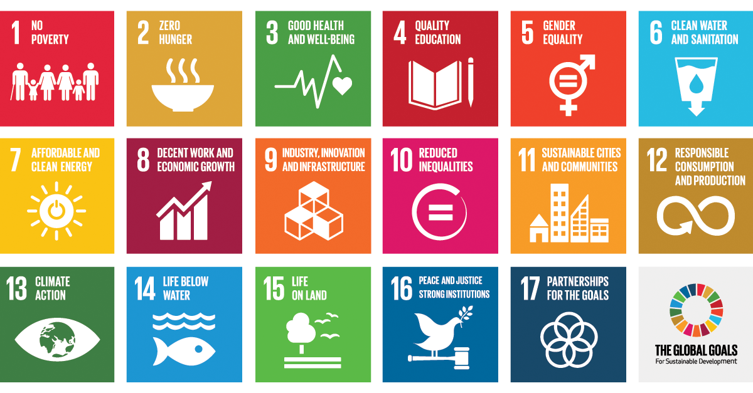
.
PROBLEM STATEMENT
Analyzing Turkey’s progress on specific SDGs between 2005-2015.
Identifying key policies and strategies behind this success.
Evaluating India’s potential to achieve net-zero emissions by 2070.
Identifying gaps and recommending measures to meet India’s climate goals.

Slide 3
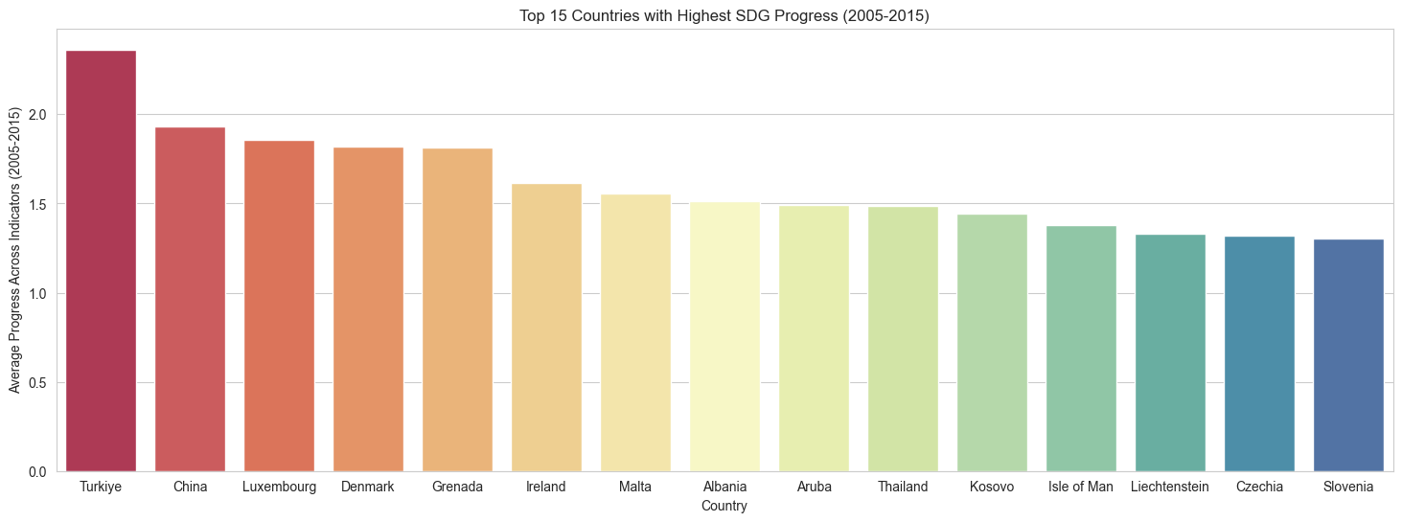
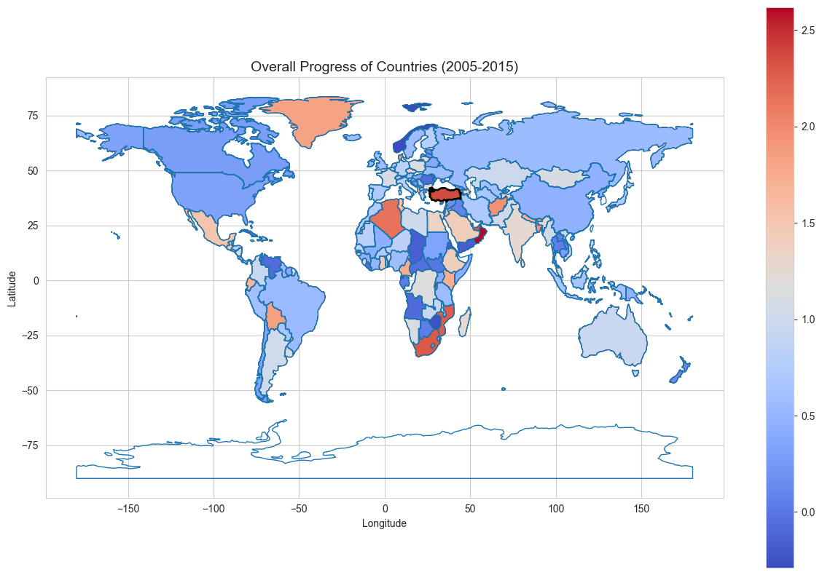
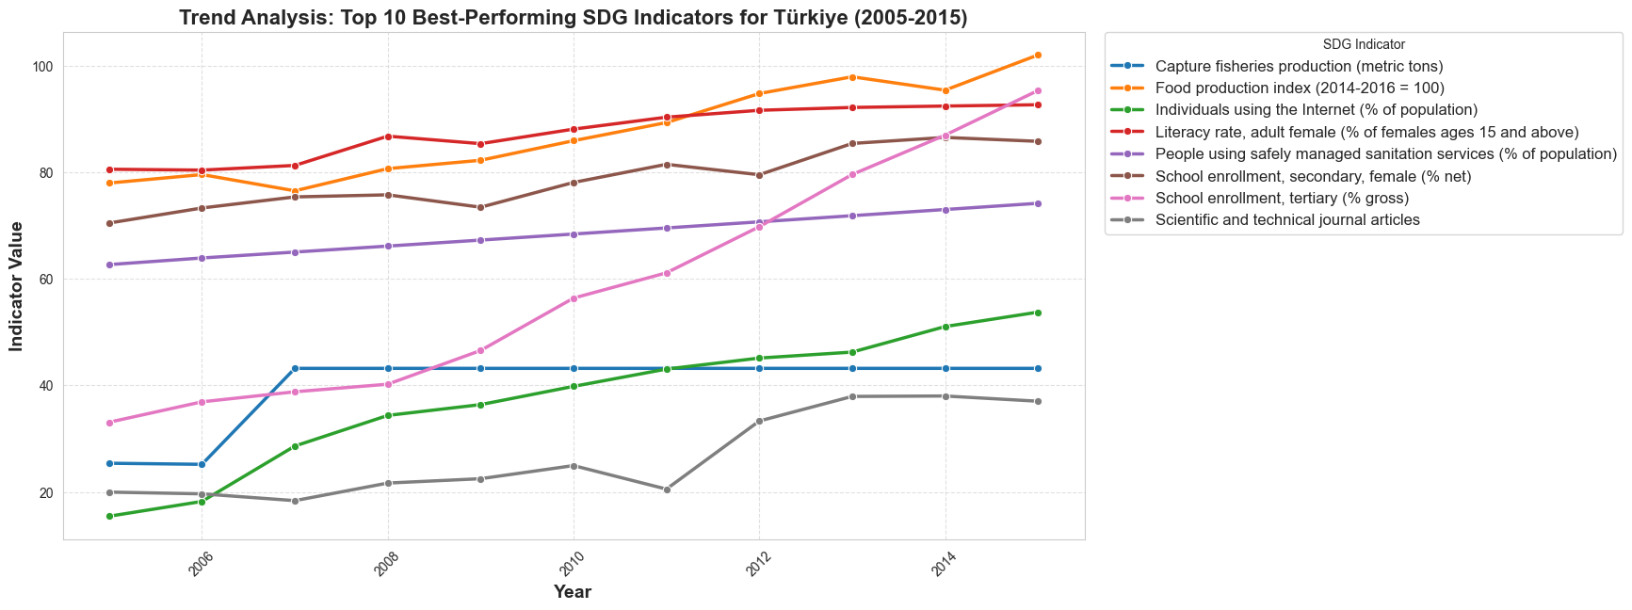
Turkey’s SDG Progress (2005-2015): Highest Growth with an Average Rate of 2.36
Why Turkey ?
A Practical Example for India’s Growth: Turkey’s impressive progress from Cluster 2 to Cluster 1 offers a strong reference point for India, showing that such a transition is achievable given their similar starting position
A Standout Performer: With an impressive average growth rate of 2.36—the highest among all countries—Turkey is the top nation to have successfully moved from Cluster 2 to Cluster 1, making its progress a valuable case study for similar transitions.
Overall growth of countries from 2005 to 2015
This world map visualization represents the overall progress of countries between 2005 and 2015. The color gradient, ranging from blue (low progress) to red (high progress), indicates the level of improvement in sustainable development or economic indicators during this period
Turkey stands out with the highest progress (highlighted in dark red), suggesting significant advancements in key indicators
Top performing indicators of Turkey
Educational and Digital Advancements: Turkey has significantly improved school enrollment, especially for females, while expanding internet access, driving human capital development and digital transformation.
Sustainability and Innovation Growth: Improvements in food production, sanitation, and scientific research highlight Turkey’s focus on better living standards, innovation, and sustainability.

Slide 4
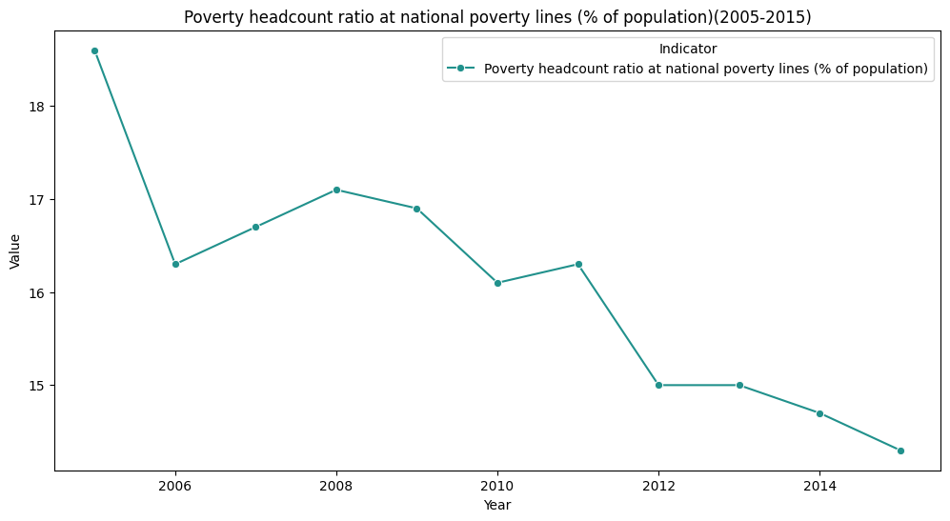
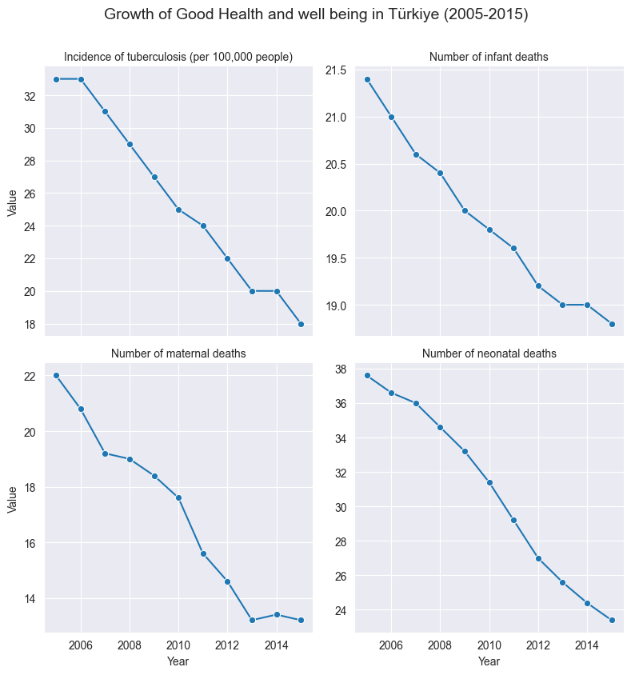
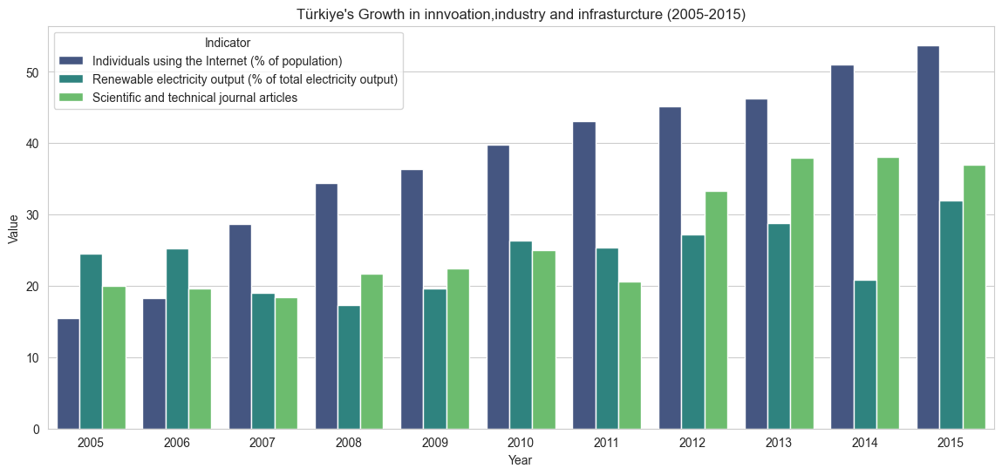
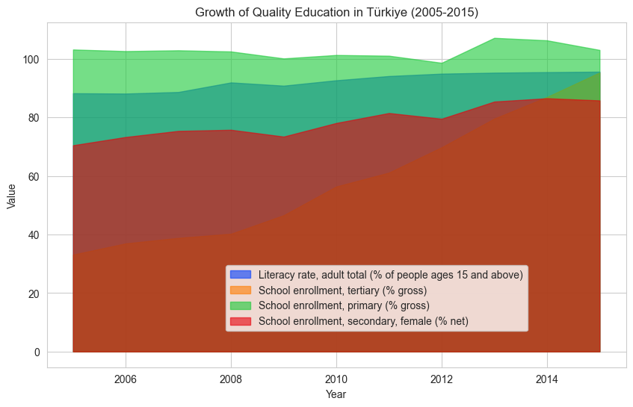
Turkey's Decade of Transformation: Key policies driving growth (2005-2015)
Turkey has shown significant development in these key indicators as evident from the graph
POLICIES:
Green Card Program: Introduced in 1992 and expanded in 2008, this program provided free healthcare to low-income individuals without social security coverage.
Labour Market Reforms: Higher labour earnings and increased employment rates among poor households were significant drivers of poverty reduction during the 2000s.
POLICIES:
Universal Health Insurance (UHI): Established in 2008, UHI consolidated various insurance schemes, ensuring healthcare access for all citizens.
Preventive Health Programs: Initiatives like the National Newborn Screening Program and vaccination campaigns significantly improved maternal and child health outcomes.
POLICIES:
Extension of Compulsory Education: In 2012, compulsory education was extended from eight years to twelve years under the "4+4+4" system, covering primary, middle, and high school education.
Curriculum Reforms: Since 2005, Turkey has shifted from a teacher-centered approach to a student-centered model emphasizing critical thinking and ICT integration.
POLICIES:
R&D Incentives: Programs like TUBITAK’s grants have supported research centers. R&D expenditure as a share of GDP has increased over time.
Infrastructure Investments: Significant investments were made in transportation networks such as highways, tunnels, and bridges to support industrial growth.

Slide 5
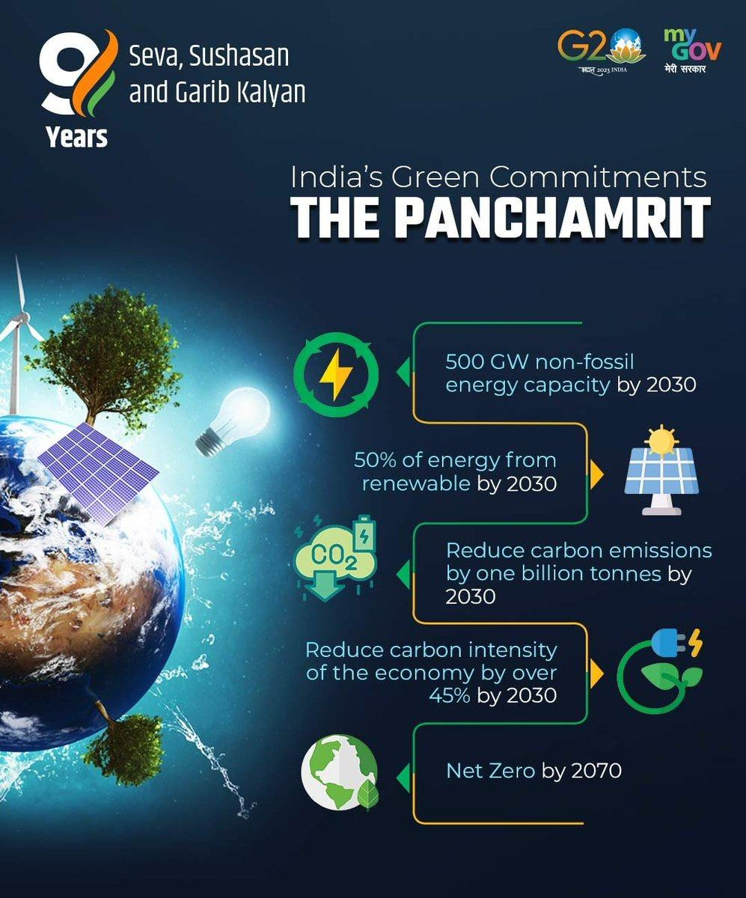
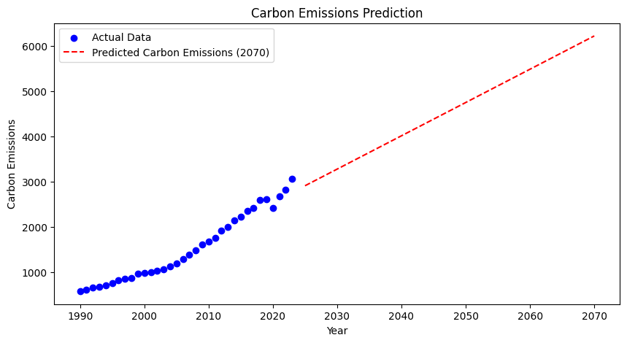
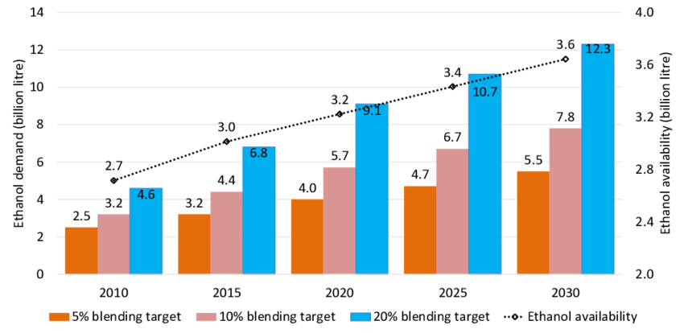
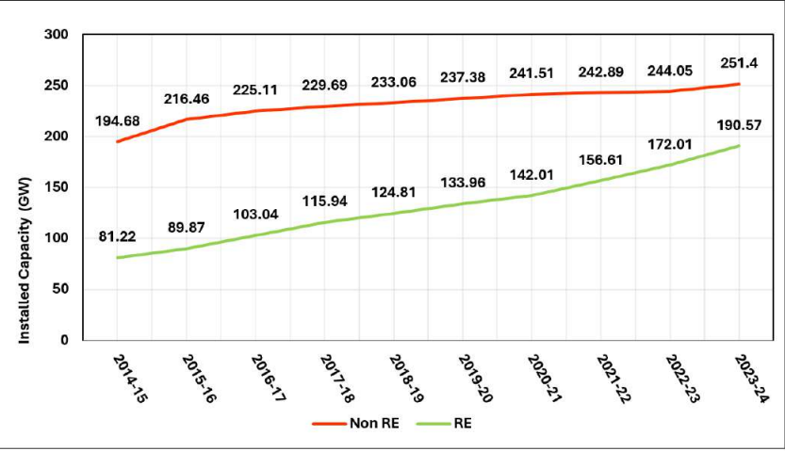
Evaluating India’s potential to achieve net-zero emissions by 2070
India’s Panchamrit commitments, announced at COP26, are a set of five ambitious climate targets:
Reaching 500 GW of non-fossil energy capacity by 2030
Meeting 50% of its energy requirements from renewable energy by 2030
Reducing total projected carbon emissions by 1 billion tones by 2030
Reducing the carbon intensity of the economy by 45% by 2030
Achieving net-zero emissions by 2070
Future Prediction for net-zero emission
The red dashed line represents the predicted carbon emissions trajectory until 2070.
Notice that the predicted carbon emissions are increasing. to achieve net-zero, this line would need to flatten out and eventually decline to zero.
(A) Renewable Energy Expansion
The graph reveals that the trend of year-wise capacity installation of renewable energy sector was consistently outpacing that of non-renewable energy sector
This reflects the increasing shift towards the utilization of renewable energy sources, with a compound annual growth rate (CAGR) of 9.94 % from 2014-15 to 2023-24
(B) Ethanol Blending
Ethanol blending (from 1.5% in 2014 to 12% in 2023) reduces oil imports.
Some Initiatives taken by India

Slide 6
Five Pillars to achieve net zero emission goal by 2070 India's path to net-zero by 2070, according to the World Economic Forum (WEF), hinges on decisive action across these five essential pillars.
Low-Carbon Energy
Decarbonization of Energy-Intensive Industries
Green Buildings, Infrastructure and Cities
Sustainable Agriculture
Green Mobility
Accelerated adoption of renewable/green energy/H2 across India
1
Promoting green cities, energy efficient buildings, and green construction technologies in future infrastructure projects
4
Transitioning to sustainable methods of farming
5
Adoption of electric, hydrogen, LPG/LNG, and other alternative green technology-based mobility platforms
2
Modernizing and decarbonizing energy-intensive industries through the adoption of green technologies and standards
3

Slide 7
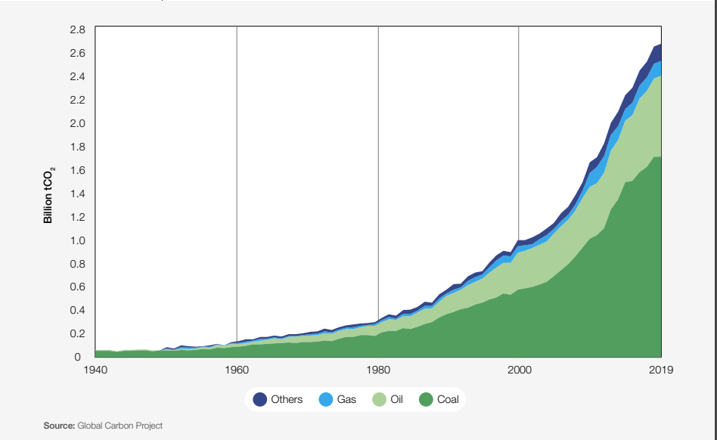
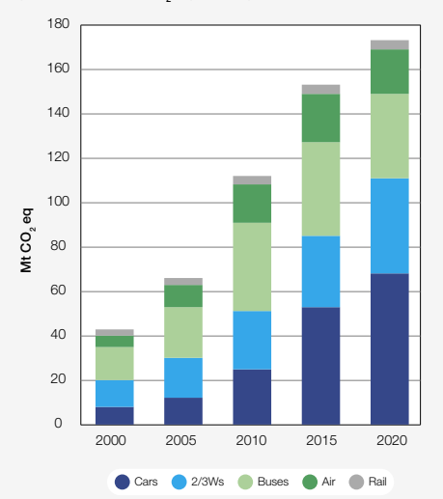
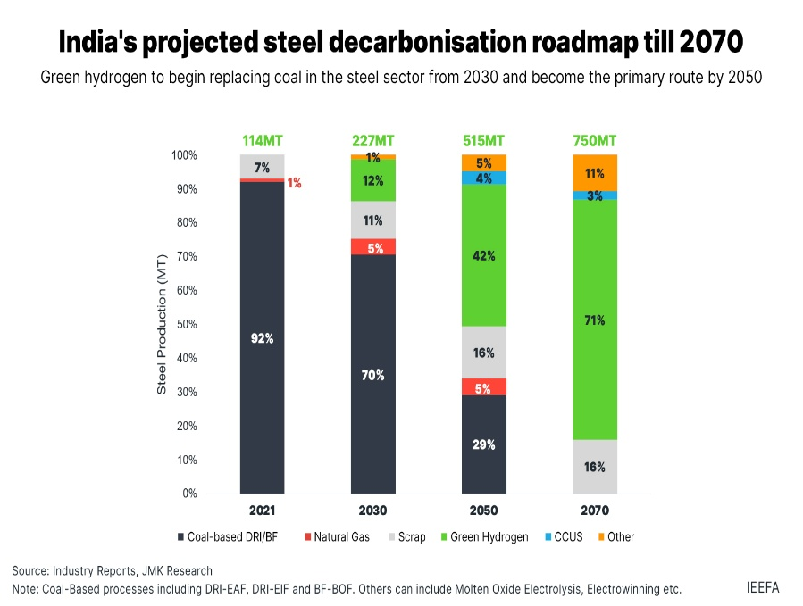
Low Carbon Energy
Green Mobility
Decarbonization of Energy-Intensive Industries
India's manufacturing sector is a key CO2 emitter, especially iron & steel, cement, and chemicals/fertilizers. A carbon-neutral growth model is crucial to meet rising demand without increasing GHG emissions
STEPS TO BE TAKEN
Demand-management measures such as circular economy
Electrification of heat with zero-carbon electricity where applicable
Green Buildings, Infrastructure and Cities
India's top 25 cities contribute over 15% of its GHG emissions, with per capita emissions 40% higher than the national average.
STEPS TO BE TAKEN
Low-carbon buildings and infrastructure
Using Sustainable Building Materials
Sustainable Agriculture
Agriculture and livestock account for 18% of India's emissions, with nitrous oxide (mainly from fertilizers) contributing ~80% of agricultural emissions. Methane, largely from livestock (80%) and rice production, makes up the remaining 20%. Sustainable practices are urgently needed due to the high warming potential of these gases.
STEPS TO BE TAKEN
Promoting Integrated Nutrient Management (INM)
Encouraging Organic Farming
India's energy sector is a major emissions source, ranking as the world's third-largest electricity consumer. Coal-based power generation accounts for 65% of total fossil CO2 emissions, contributing significantly to the country's environmental impact.
STEPS TO BE TAKEN
REPLACE legacy fossil fuel energy infrastructure with renewables.
REDUCE emissions from legacy fossil fuel infrastructure – through enhanced efficiencies.
The transport sector is responsible for approximately 10% of India's greenhouse gas emissions. Passenger transport comprises 60% of the sector's energy use, with freight transport making up the remaining 40%
STEPS TO BE TAKEN
Shift in Transport Modal Mix (from Road to Rail)
Green Fuel and Green Vehicles
.

Slide 8
Conclusion
Case Study of Turkey:
Turkey has outperformed all the countries with respect to the growth it has shown in SDG indicators from 2005 to 2015.
Having the highest growth average of 2.36, Turkey has shown significant growth in SDG indicators like Internet usage, education, food production, and sanitation.
Reasons for Turkey's significant growth is the implementation of several policies by the government integrating Sustainable Development in National Development Plan (NDP) resulting in policies like Green card Program , Universal Health Insurance(UHI), Extension Of Compulsory Education etc .
India's Path to Net-Zero Emission:
At 26th Conference of the Parties to the United Nations Framework Convention on Climate Change (COP26) India has set five ambitious goals( Panchamrit) including Net Emission Zero by 2070.
Despite data indicating that India is currently not on track to achieve net-zero emissions by 2070, the government's active implementation of policies promoting renewable energy adoption, decarbonization, and sustainable infrastructure demonstrates a firm commitment to accelerating progress and bridging the gap towards a low-carbon future.
To achieve this goal of Net Emission Zero By 2070, India should focus on these five pillars including Low Carbon E, Green Mobility, Decarbonization of Energy-Intensive Industries, Green Buildings, Infrastructure and Cities and Sustainable Agriculture.

Slide 9
References
Given Dataset of SDG indicators from 2005 to 2015
www.worldeconomicforum.org
www.outlookbusiness.com/planet
dashboards.sdgindex.org/profiles

Slide 10


